Slide 1

Authorized Data Deduplication Using Hybrid Cloud
Submitted By,
Vineesha N B

Slide 2
INTRODUCTION
Now a days use of cloud computing is increasing rapidly.
As the data is get uploaded by the user every day it is critical task to manage this ever increasing data on the cloud.
Deduplication is best method to make well data management in the cloud computing.
Using the data Deduplication method, we can reduce the size of similar data in cloud.
This project’s main aim is to remove duplicate data from cloud and also help to save storage space and bandwidth.

Slide 3
aa
DESCRIPTION
This framework is managed by an admin.
Admin and User are the users who interact with the system.
The files uploaded by the user are saved in the cloud with a signature and the pushing details will be logged in the cloud.
When multiple users upload the same content file, the cloud identifies the file which is already present or not by using the signature.
If the same content files are trying to push, the cloud identifies that and logs its details. But only one file will be in the cloud.

Slide 4
System Requirements
Hardware Requirement
Intel Core i5 (and above) Processor
64-bit architecture
4GB (and above) RAM
Software Requirements
Operating System: Windows 11
Front end: Python Django
Back end: SQLite
Integrated Development Environment: PyCharm

Slide 5
Existing System
Cloud computing provides a large amount of virtual environment hiding the platform and operating systems of users.
Users use the resources for sharing data. But users have to pay as per the use of resources of the cloud.
Security and less protection of sensitive data in cloud computing is still the biggest challenge.

Slide 6
Proposed System
This proposed method is to remove the duplicate data in which the user has assigned some privilege according to the duplication check & each user has their unique token.
Cloud Deduplication is achieved using the hybrid cloud architecture.
This proposed method is more secure and consumes fewer resources of the cloud.
Also, it shows that the proposed scheme has minimal overhead in duplicate removal as compared to the normal Deduplication technique.
In this project, Content Level Deduplication, as well as File Level Deduplication of file data, is checked over the cloud.

Slide 7
The system has the following users:
Admin
User

Slide 8
Admin
Modules
Admin can do the following functions:
View the user
View user feedback
Access the ownCloud

Slide 9
User
Users can do the following functions:
Add, view, and manage files
Search the stored files
View storage use
Give feedback

Slide 10
DFD Level 0
Request
Infotech
Request
User
Admin
Response
Response

Slide 11
DFD Level 1 - User
Registration
Request for registration
User details
User
Login
Request for login
Success
Infotech

Slide 12
DFD Level 1 - Admin
Login
Request for login
Infotech`
Admin
Validate user
User details
Validate user details

Slide 13
DFD Level 2 - User
Add
files
User
Add new files
user_file_store_add
View files
View existing files
user_file_store_view
View user storage
View storage details
user_storage_view
Give
feedback
Send feedback to admin
user_feedback_add

Slide 14
DFD Level 2 - Admin
View users
Admin
View user details
admin_user_view
View feedback
View user feedback
Admin_user_feedback_view
Access ownCloud
ownCloud accessing to view all stored files
View all stored files

Slide 15
ER Diagram
Registration
id
user_id
username
password
fname
lname
User
gender
Admin
age
addr
Upload
Send
pin
file name
contact
file size
email
Feedback
action
My files
Files
View
Storage
file count
free size
file size
used size

Slide 16
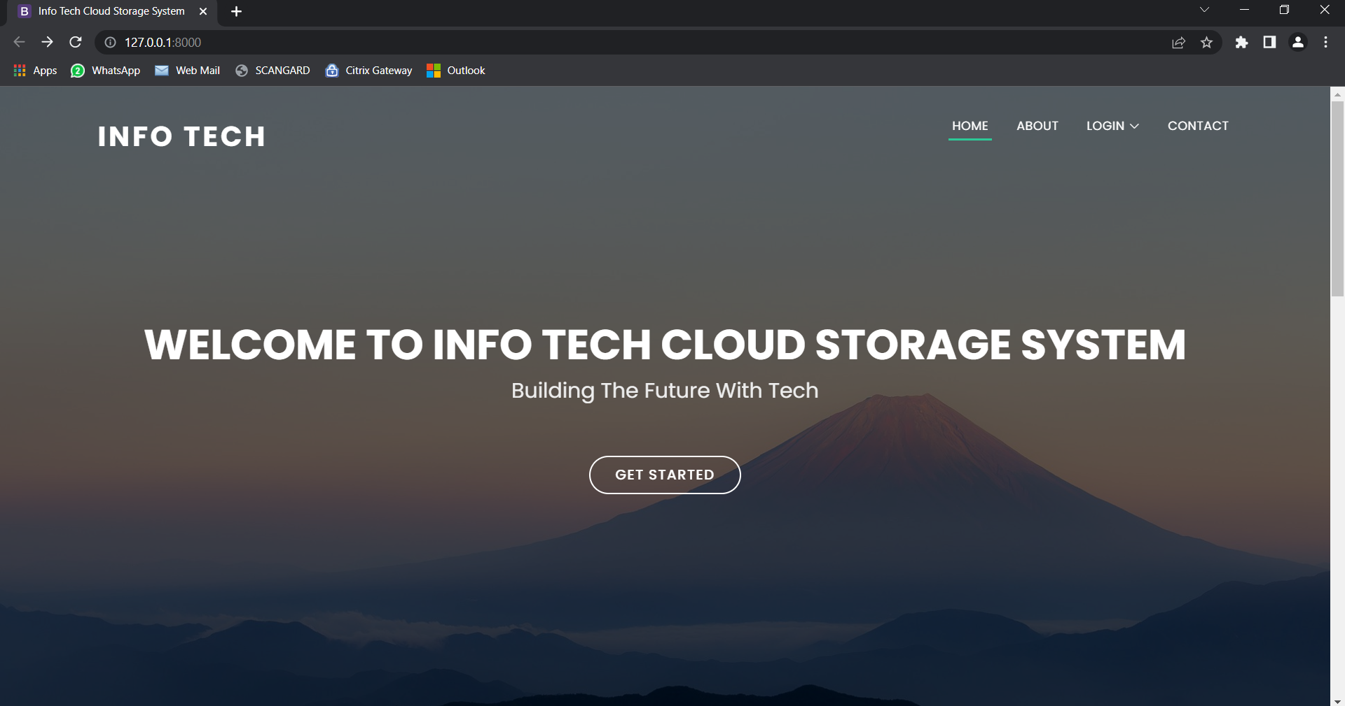
Sample Screenshots

Slide 17
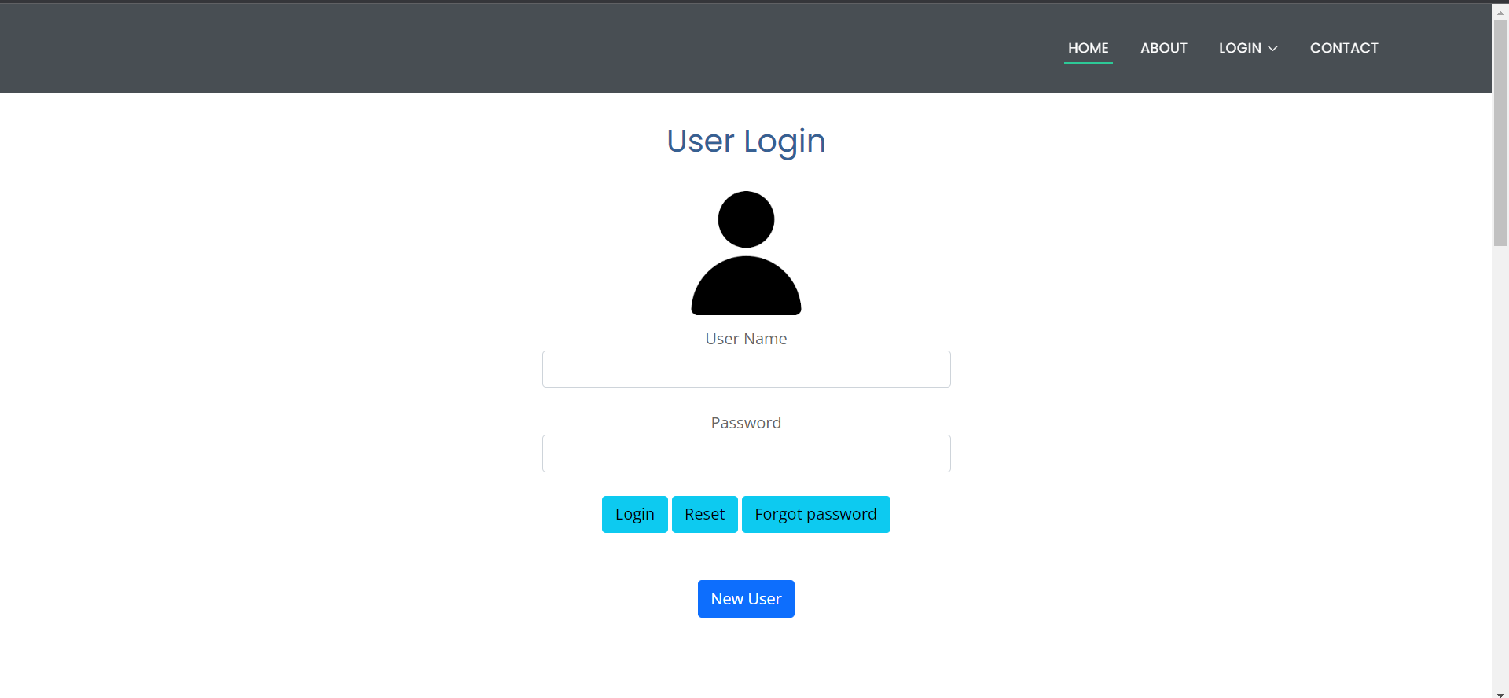

Slide 18
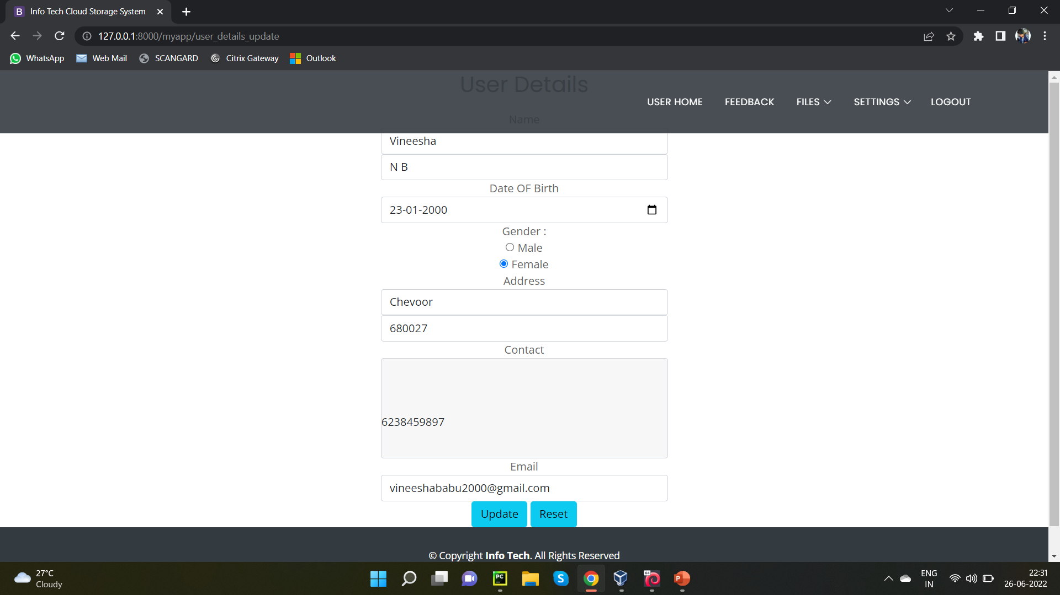

Slide 19
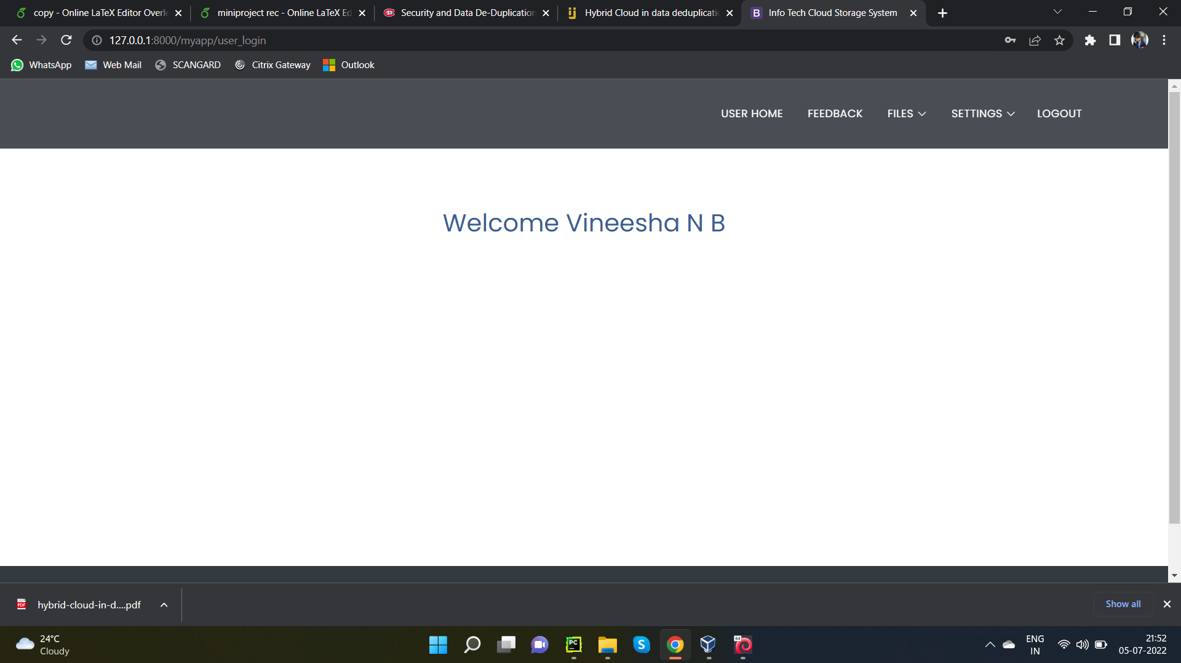

Slide 20
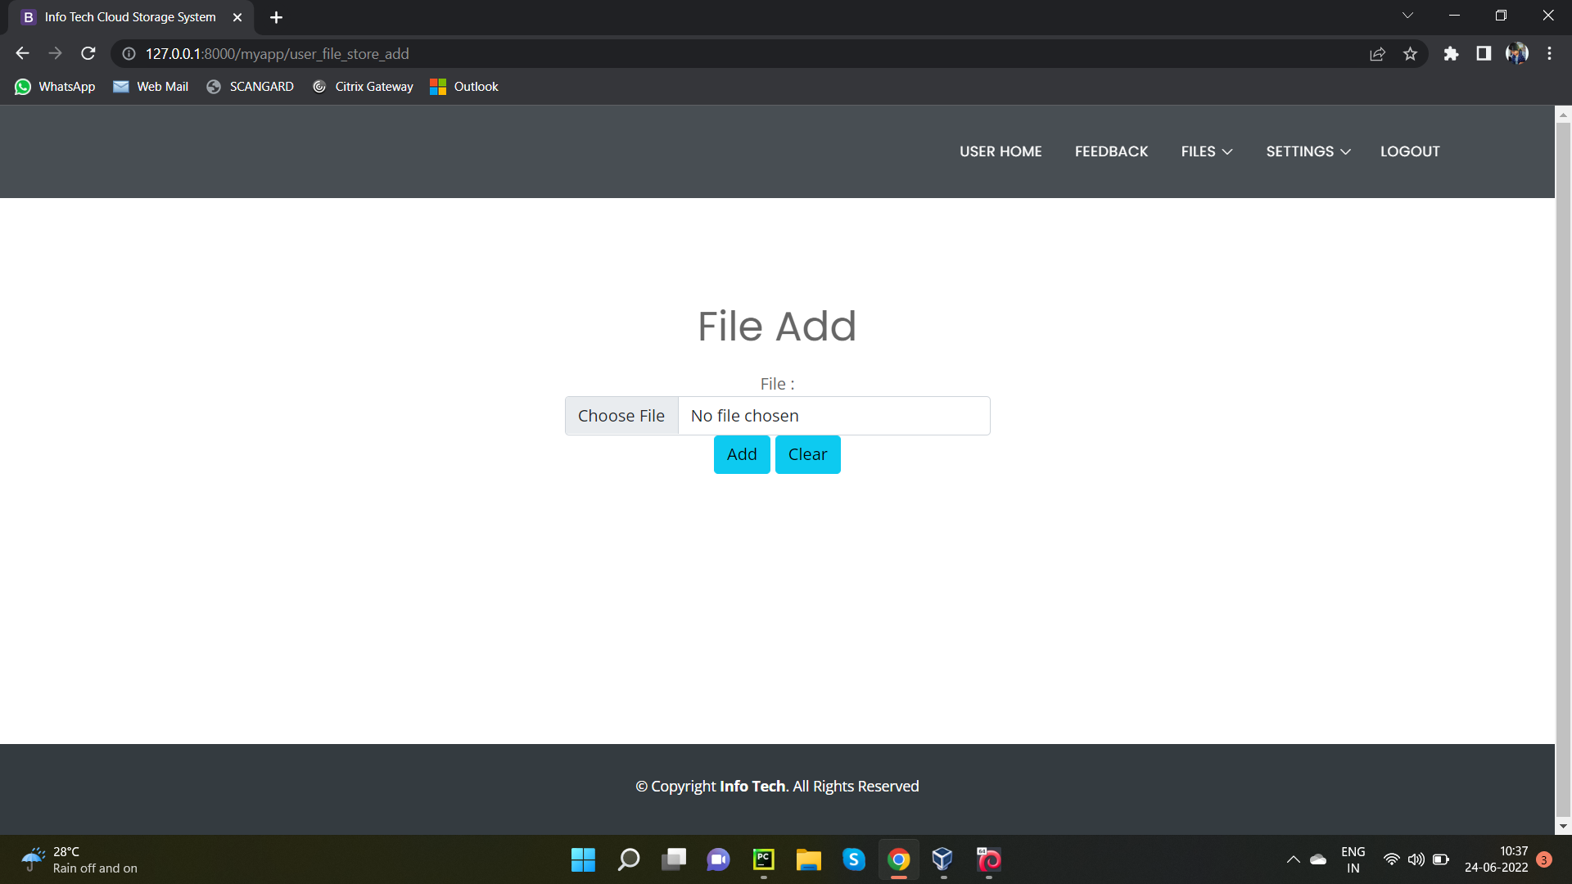

Slide 21
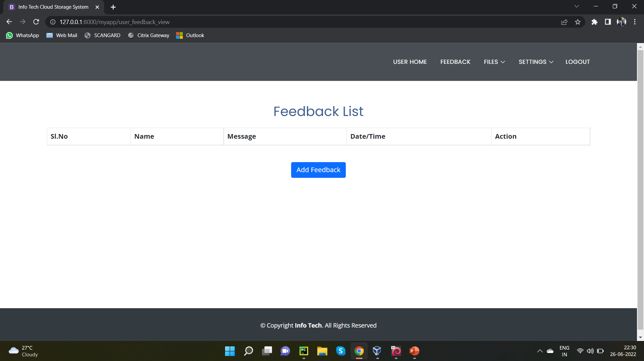

Slide 22
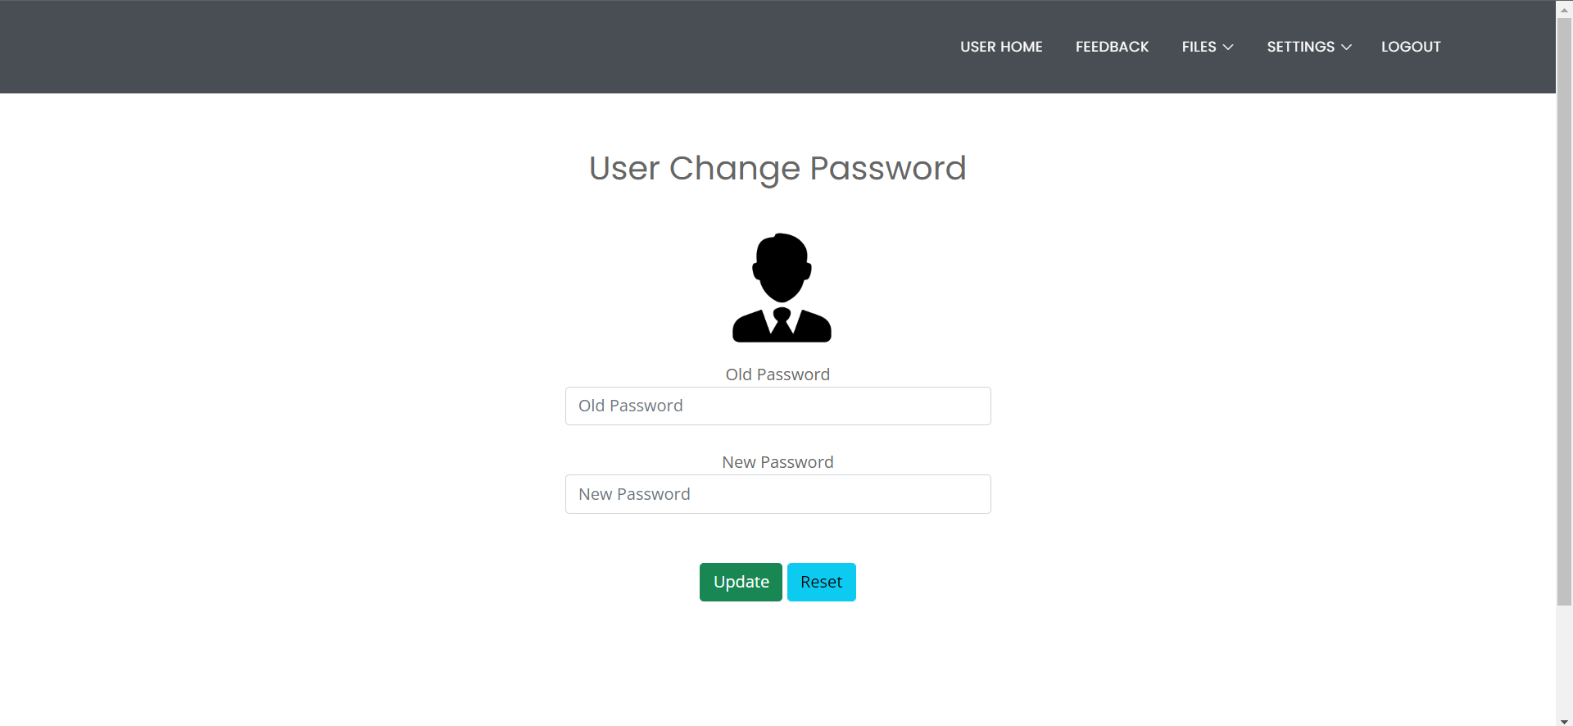

Slide 23
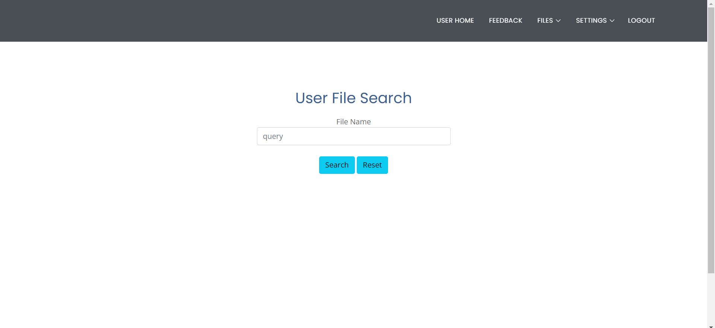

Slide 24
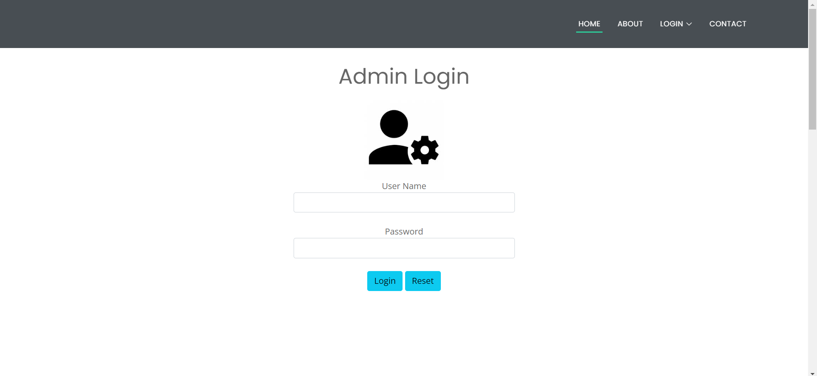

Slide 25
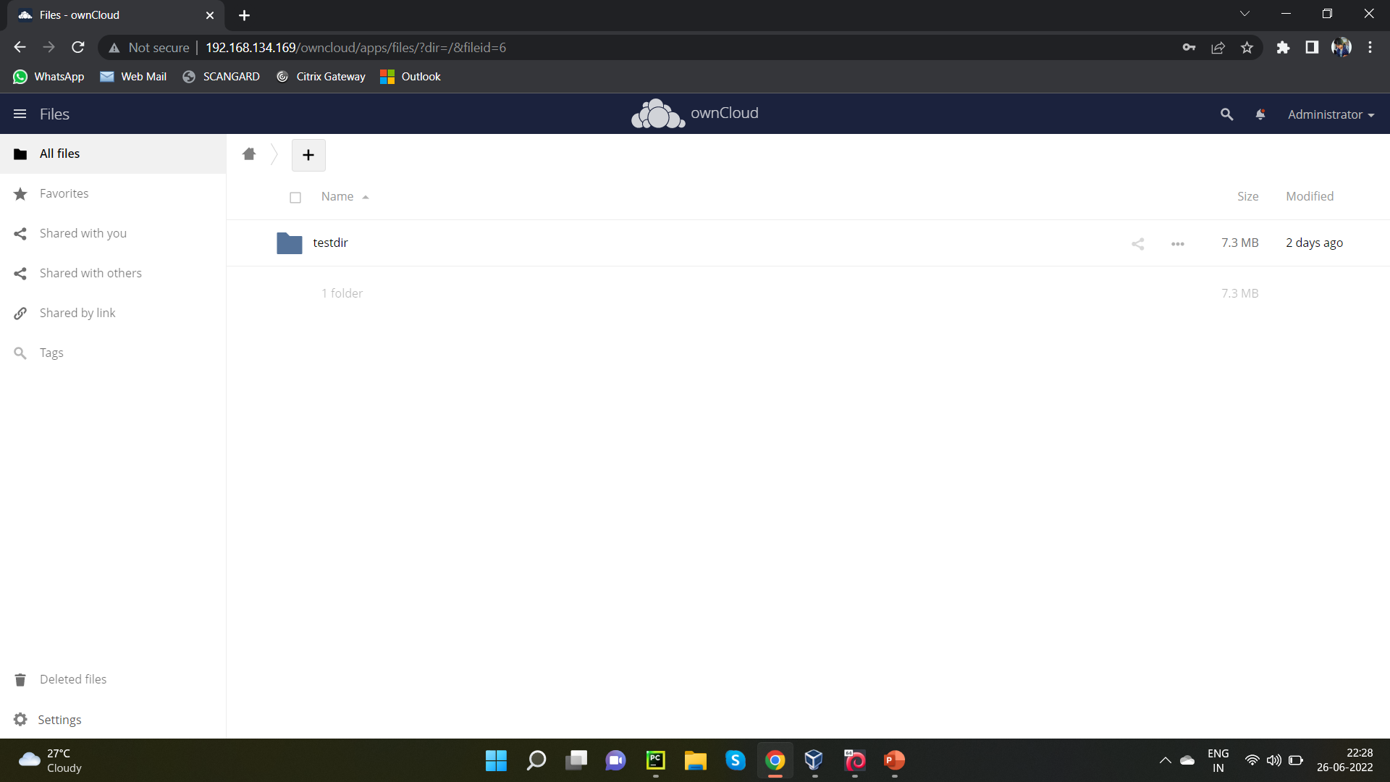

Slide 26
Thank You

